Slide 1


K.RAMAKRISHNAN COLLEGE OF TECHNOLOGY
(AUTONOMOUS), TRICHY.
DEPARTMENT OF
COMPUTER SCIENCE AND ENGINEERING
20CS5501 DESIGN PROJECT-1
Batch No : 12
Date : 07.12.2024

Slide 2
NON ACADEMIC CREDIT CALCULATOR
Guided by Team
Mrs.K. VALLI PRIYADHARSHINI M.E (Phd) SRINIVAS J G (811722104155)
Assistant Professor, CSE SRIRAM G (811722104156)
SUBBIAH KARTHICK S
(811722104157)

Slide 3
OBJECTIVE OF THE PROJECT
Develop a web-based application for managing non-academic credits.
Enable students to upload certificates of extracurricular achievements.
Calculate credit points based on predefined criteria. Provide staff functionality to validate student credits.
Recognize and reward student involvement in non-academic activities.

Slide 4
ABSTRACT
To assess and quantify the extracurricular and non-academic activities of students ,providing a comprehensive evaluation of their skills and achievements.
The system calculates credits based on pre-defined criteria.
It provides a balanced score that can be integrated into a student’s overall profiles.

Slide 5
LITERATURE SURVEY
TITLE OF THE PAPER | AUTHOR (S) | PUBLISHER | PAPER GIST | TECHNOLOGY USED
Design and Implementation of a Web Based Leave Management System | Alade, Samuel Mayowa, Adejumo, Samuel , Alade, Temitope John | International Journal of Computer Applications Technology and Research (2022) | Leave management systems for African businesses. Use of technology to automate processes. Improve staff management efficiency. Incorporate stakeholder input. | - Intranet-Based Systems - Three-Tier Architecture - USSD System - Python with Django Framework
Managing Students’ Electronic Disciplinary Records Via E-Merit Web Content Management System | Mohd Idzwan Mohd Salleh, Mohamad Rahimi Mohamad Rosman, Raja Abdullah Raja Yaacob, Zulkarnain Yusoff | IEEE Conference on Open Systems (2011) | Importance of secure systems for electronic record management. Ensuring record authenticity through digital signatures. Protecting data integrity in electronic systems. | Electronic Records Management Systems (ERMS) Information and Communication Technology (ICT) Systems System Development Life Cycle (SDLC)

Slide 6
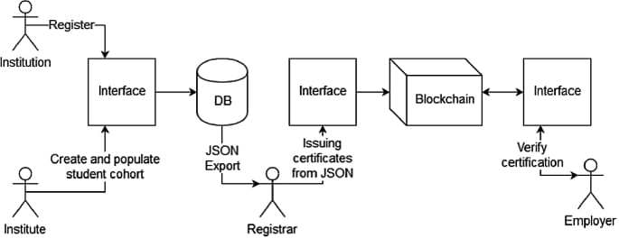
PROPOSED SYSTEM ARCHITECTURE

Slide 7
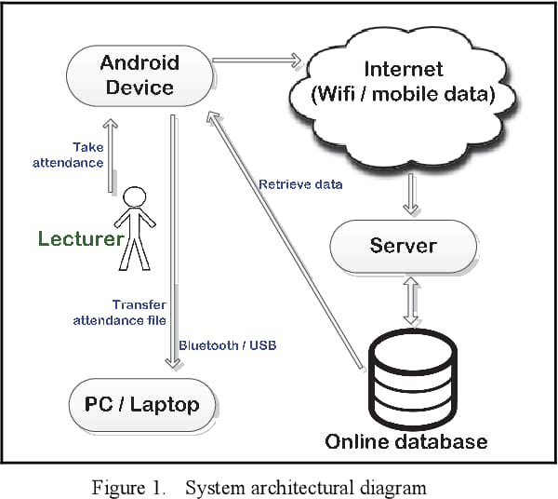
EXISTING SYSTEM ARCHITECTURE

Slide 8
SOFTWARE AND HARDWARE REQUIREMENTS
HARDWARE
SOFTWARE
Server: Intel(R) Core i5 8th GEN Processor,8GB RAM,Fast storage,Secure Windows OS.
Database server:WAMP Server (Windows,Apache,MySQL,PHP).
Network:Fast Connection,Low latency,Traffic management,Content Optimization.
JDK: Java Development Kit
Database: MySQL
Web server: WAMP Server
Deployment tools: Docker or Kubernetes

Slide 9
MODULES
User and Profile Management
Activity Submission and Credit Calculation
Credit Management
Certificate Validation and Notifications
Reporting and Communication

Slide 10
SUMMARY OF MODULE-1 User and Profile Management
Account Creation and Authentication (Students and Staff)
Profile Management (View/Update Personal Information)
Role-based Access Control (Student, Staff)
Multi-factor Authentication (Enhanced security for user accounts)

Slide 11
SUMMARY OF MODULE-2 Activity Submission and Credit Calculation
Upload and Describe Activities (e.g., workshops, volunteering)
Assign Categories/Tags to Activities
Automatically Calculate and Assign Credits Based on Defined Criteria
Activity Status Tracking (Track submission, review, and approval stages)

Slide 12
SUMMARY OF MODULE-3 Credit Management
View and Track Earned Credits (Students)
Validate and Manage Credits (Staff)
Maintain Credit History and Logs
Credit Adjustment Requests (Allow students to request changes or reviews of credits)

Slide 13
SUMMARY OF MODULE-4 Certificate Validation and Notifications
Certificate Upload and Validation Process (Staff Review and Approval)
Notification System (Credit Updates, Submission Status, Approvals)
Expiration and Renewal Alerts (Notify users of expiring certificates or activities)

Slide 14
SUMMARY OF MODULE-5 Reporting and Communication
Generate and View Reports on Student Credits and Activities
Analyze Data and Export Reports (e.g., CSV, PDF)
Messaging and Feedback between Students and Staff
Custom Report Filters (Ability to filter reports based on time, activity type, or credit range)

Slide 15
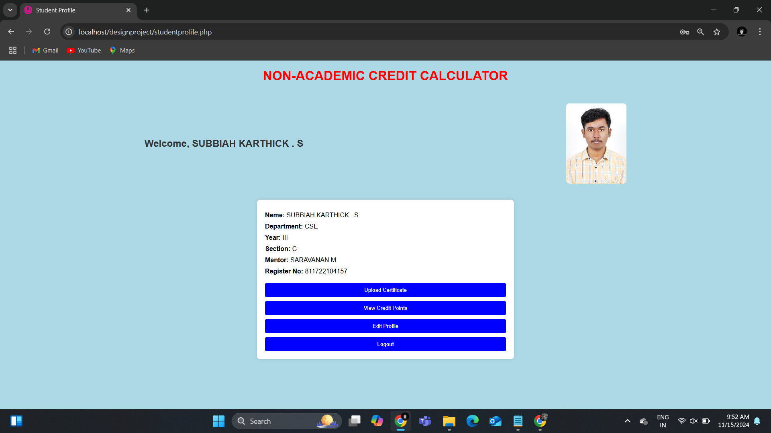
RESULTS AND DISCUSSION
Student Profile of Non Academic Credit Calculator Account
INPUT:

Slide 16
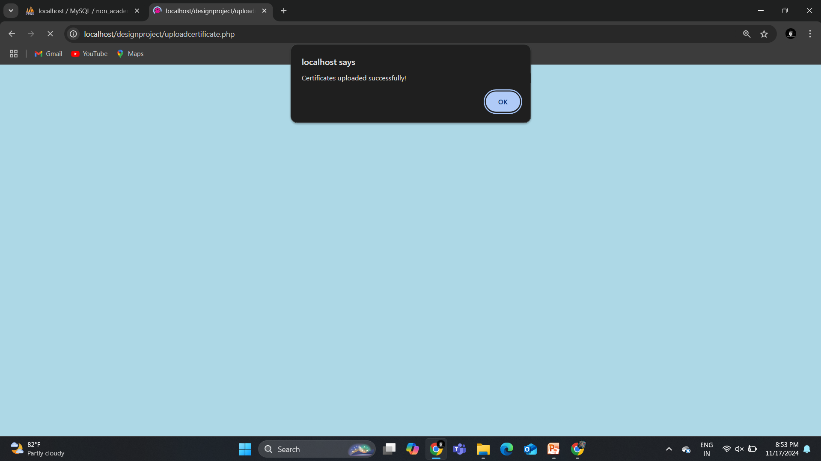
RESULTS AND DISCUSSION
Therefore,Student uploaded his certificate successfully.
INPUT:

Slide 17
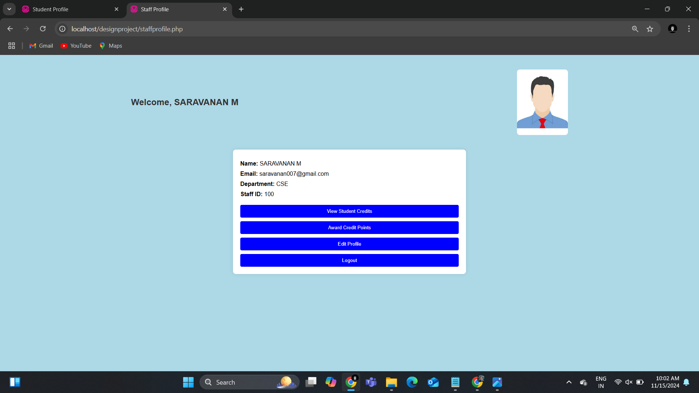
RESULTS AND DISCUSSION
Staff Profile of Non Academic Credit Calculator Account.
INPUT:

Slide 18
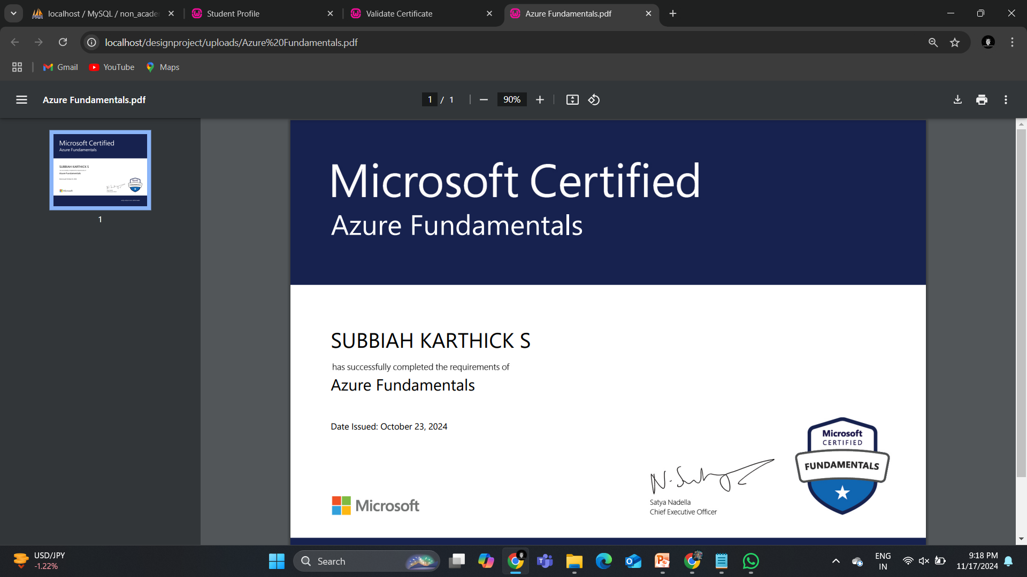
RESULTS AND DISCUSSION
Here , Staff verifying the certificate manually.
OUTPUT:

Slide 19
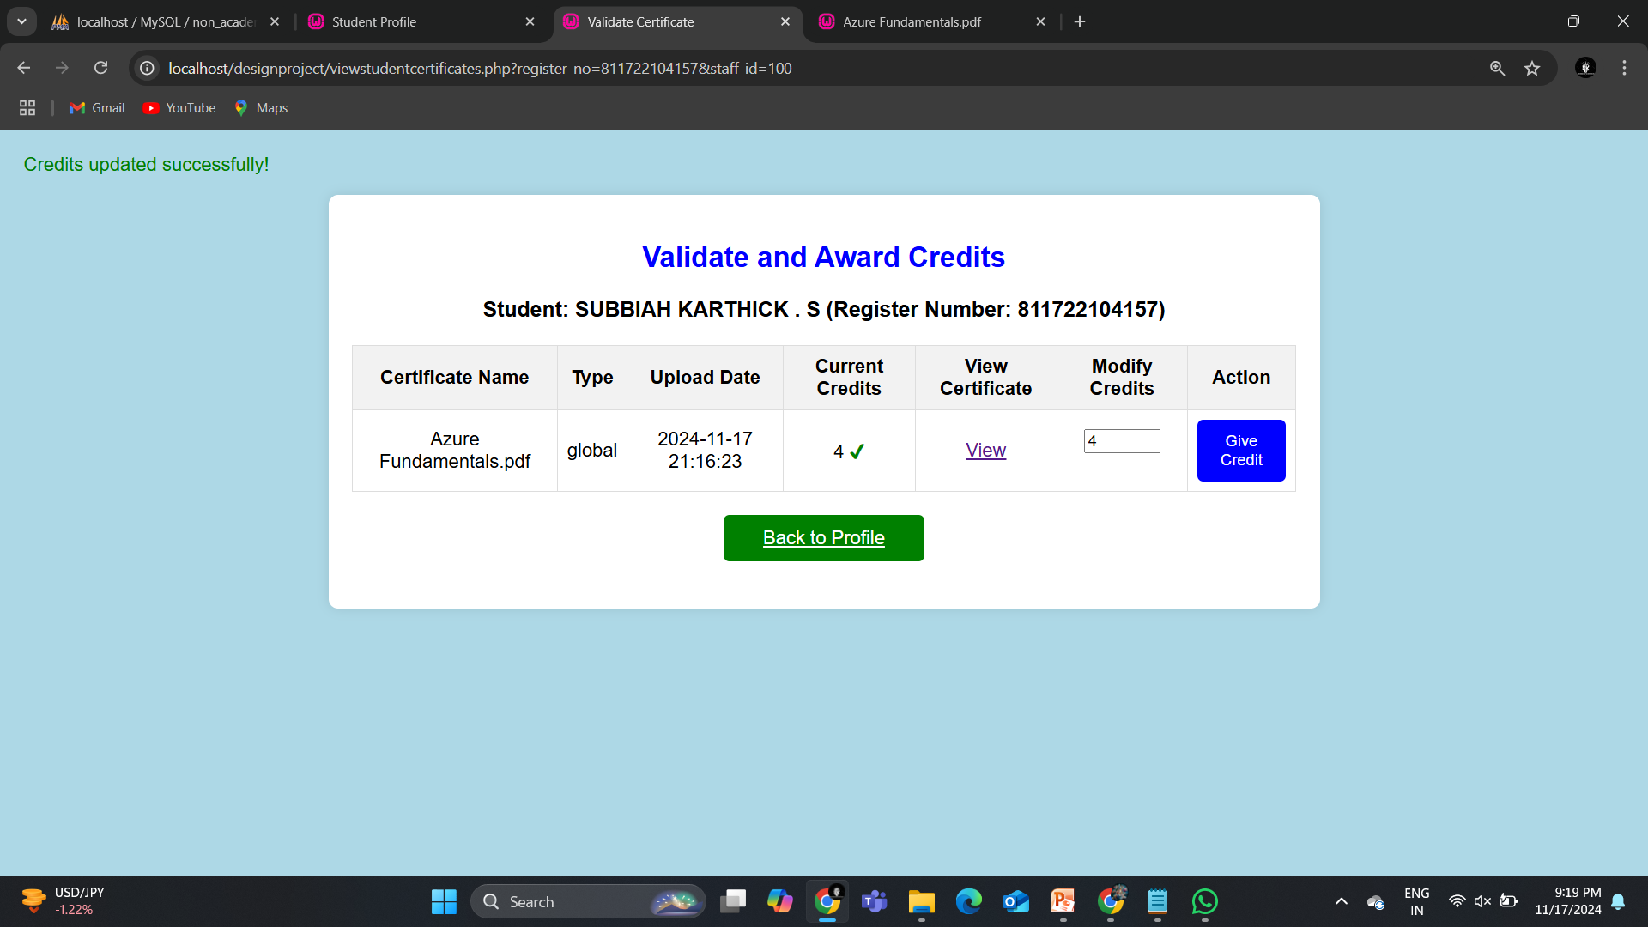
RESULTS AND DISCUSSION
After verification, Staff provides credit points for the uploaded certificate.
OUTPUT:

Slide 20
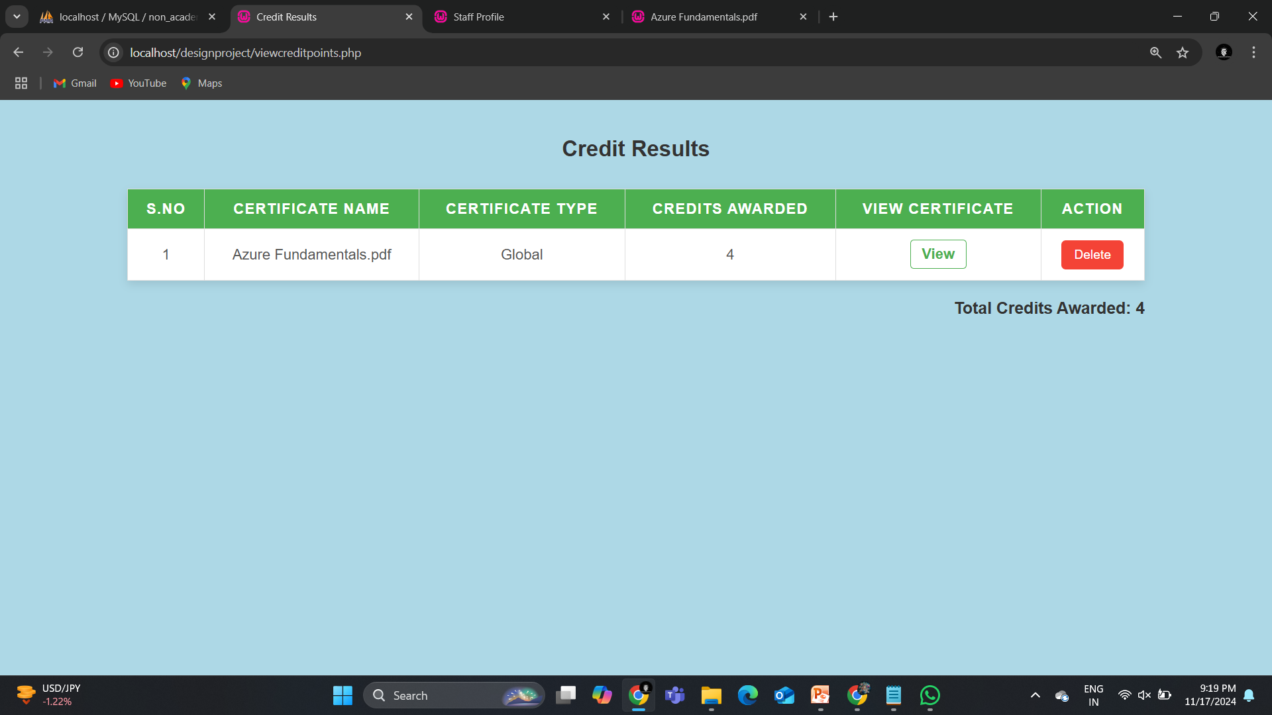
RESULTS AND DISCUSSION
Similarly, Student can also view his overall credit points as well as individual credit points for each certificate.
OUTPUT:

Slide 21
CONCLUSION
In conclusion, the Non-Academic Credit Calculator offers an innovative solution for
Recognizes non-academic achievements.
Automated credit calculation enhances transparency.
Encourages student participation.
Supports staff in efficiently managing and validating credits. Promotes holistic student development.

Slide 22
THANK YOU

